Slide 1
Introduction to the Deployment pipeline
Len Bass
Notes:
This is the slide title. The title of the lecture topic goes in:
<Lecture Title Here>
The lecturer should put their name in:
<Presenter’s Name Here>

Slide 2
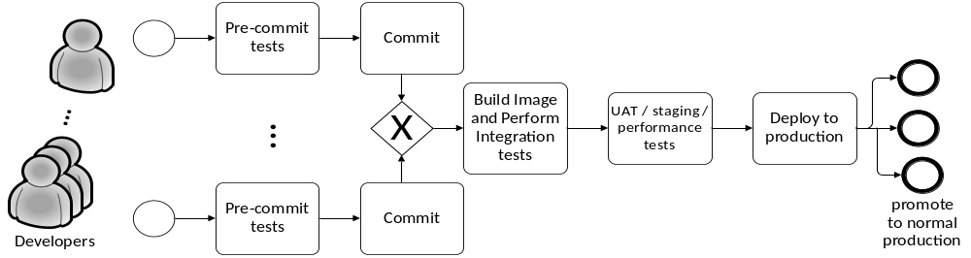
Deployment pipeline
Developer creates and tests code on local machine.
Checks code into a version control system
Continuous integration server (CI) builds the system and runs a series of integration tests.
After passing the tests, the system is promoted to a staging environment where it undergoes more tests including performance, security, and user acceptance tests.
After passing those tests, the system is promoted to provisional production where it undergoes even more tests.
The system is finally promoted to normal production but the tests do not necessarily stop.
copyright 2016 Len Bass

Slide 3
Goals during deployment pipeline
Team members can work on different versions of the system concurrently
Code developed by one team member does not overwrite code developed by others
Code produced by one team can be integrated with code produced by other teams
Code is the same during different stages
Different stages serve different testing purposes
Different stages are isolated from each other
A deployment can be easily rolled back if there is a problem.
copyright 2015 Len Bass

Slide 4
Desirable qualities of deployment pipeline
Traceability
Testability
Tooling
Cycle time
© Len Bass 2016

Slide 5
Traceability
When any code gets into production, it must be reconstructable
  All components that go into the executable image can be identified
  All tests that were run can be identified
  All scripts used during the pipeline process can be identified.
When a problem occurs in the system when it goes into production, all of the elements that contributed to the system can be traced.
copyright 2015 Len Bass

Slide 6
Testing
Every stage (except production) has an associated test harness.
Tests should be automated.
Types of tests are
  Sunny day tests
  Negative tests
  Regression tests
  Static analysis
We will discuss stage specific tests when we discuss the stage.
copyright 2015 Len Bass

Slide 7
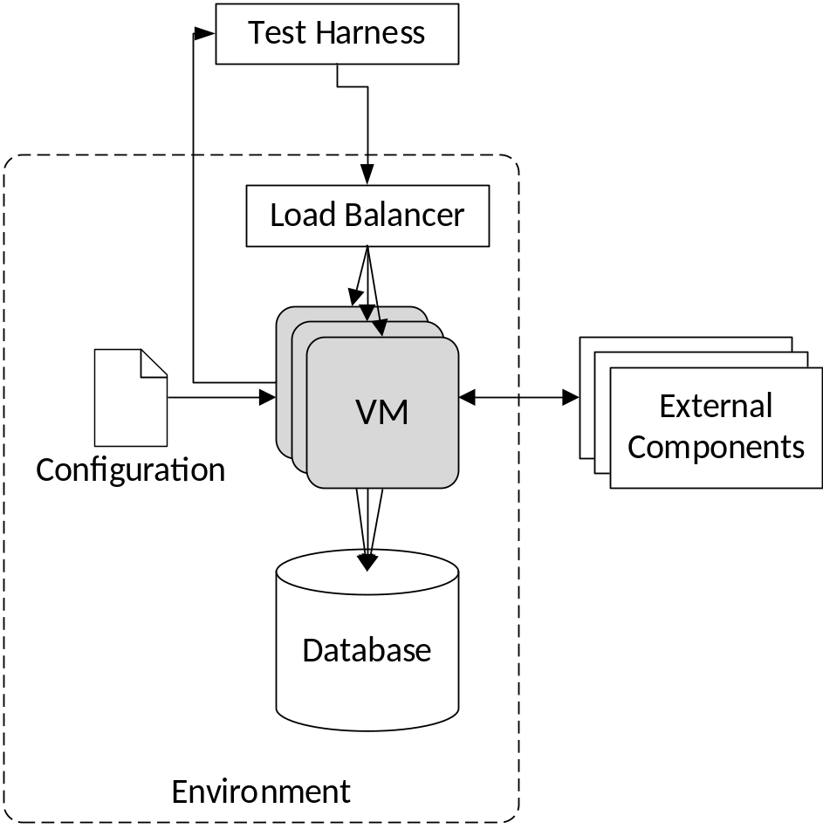
Test Harness
A test harness generates inputs and compares outputs to verify the correctness of the code.
copyright 2015 Len Bass

Slide 8
Tooling
Version control system – manages different versions for development and production – e.g. Git
Configuration management tool – controls configuration of deployed image – e.g. Chef, Puppet, or Ansible
Continuous Integration tool – builds image and runs test – e.g. Jenkins
Deployment tool – places images into production. E.g. Spinnaker, Ansible, Chef
copyright 2015 Len Bass

Slide 9

Tools in Context
  Git, Jenkins and Ansible must execute on a platform
  The platform for your assignments is VirtualBox although one assignment will be on Amazon Web Services (AWS).
  Vagrant is a tool to help provision the platform
Git
Jenkins
Ansible
© Len Bass 2015

Slide 10
Cycle time
Cycle time is the time between the commit and the placing into provisional production.
Systems should move through the pipeline quickly
The time depends on
  How large are the components that are constructed in the build stage
  How long does it take to run tests on the system
© Len Bass 2016

Slide 11
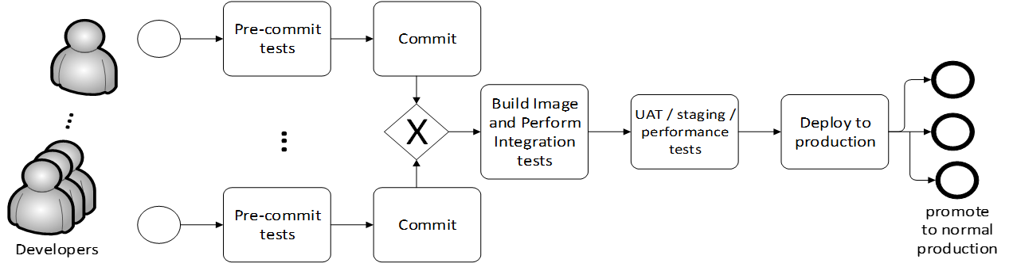
Different environments in pipeline
Development environment
Integration environment
Staging environment
Production environment
Different organizations may have additional environments defined
copyright 2015 Len Bass

Slide 12
Summary
A deployment pipeline is a series of stages where each stage has
  A specific testing purpose
  An isolated environment
Each stage in the pipeline is controlled by some set of tools.
The pipeline has a set of desirable properties that can be used to measure it
© Len Bass 2016

